Slide 1
Validation of CASM to
Study 21-a1Two Applications
Toxic Effects
SM Bartell
Stantec
April 6, 2023

Slide 2
Methods: CASM validation to 21-a1 Two Applications exposure scenario
Previous CASM simulation of study 21-a1 control data used as baseline
Toxic effects benchmarks derived for study 19b
Perform toxic effects simulations using 21-a1 exposure profile
Toxic effects simulation results analyzed
  Direct effects for selected populations (e.g., effects criteria tables)
  Indirect effects
Plot results
  Abundance for control and treatment simulations
  Percent impacts

Slide 3
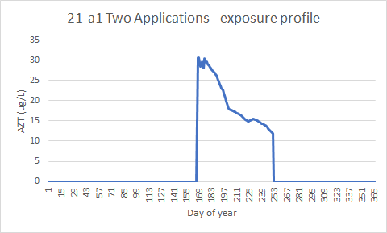
Daily concentrations of AZT used in CASM simulations for study 21-a1: Two Apps

Slide 4
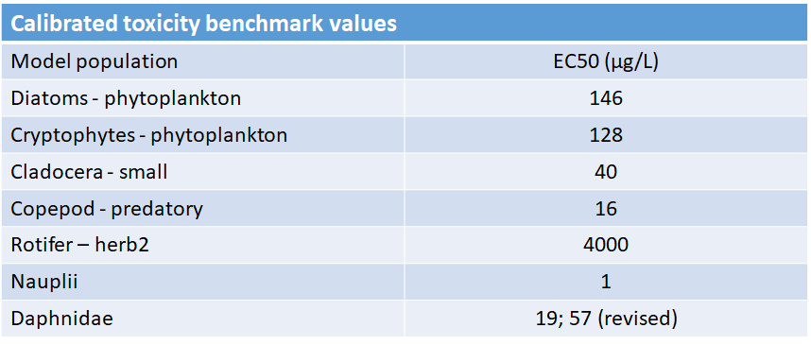

Slide 5
Effects Criteria Populations

Slide 13
Other Impacted Populations

Slide 14
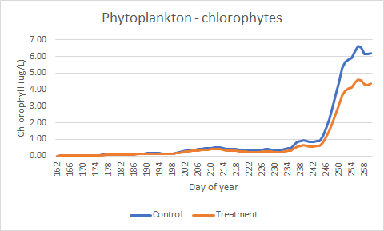

Slide 15
